Slide 1
PLC Programming
Part 2
Using a Control Structure to write a PLC sequence

Slide 2
PLC Programming
In Part 1, we discuss a basic control structure and programming paradigm, Structure programming, to aid in software development.
In Part 2, we are going to discuss how to use the control structure to write your programs

Slide 3
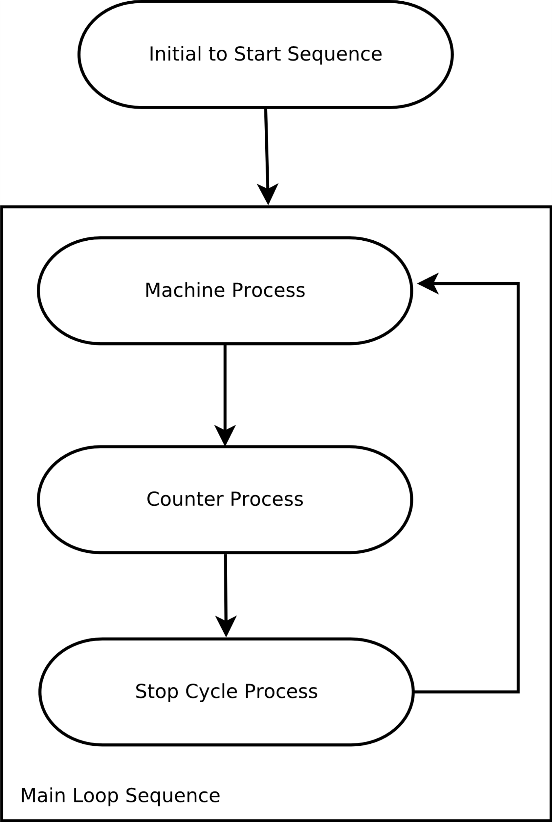
PLC Programming
Machine programs consist of
  Initialization Sequence
    Serve to prep the system for the main sequence
    Runs once at the start of the machine process
  Main Loop Sequence
    Serve as the Top-Level Loop Sequence
    Contains
      Machine Process
      Counter Process
      Stop Cycle Process

Slide 4
PLC Programming
Main Loop Sequence

Slide 5
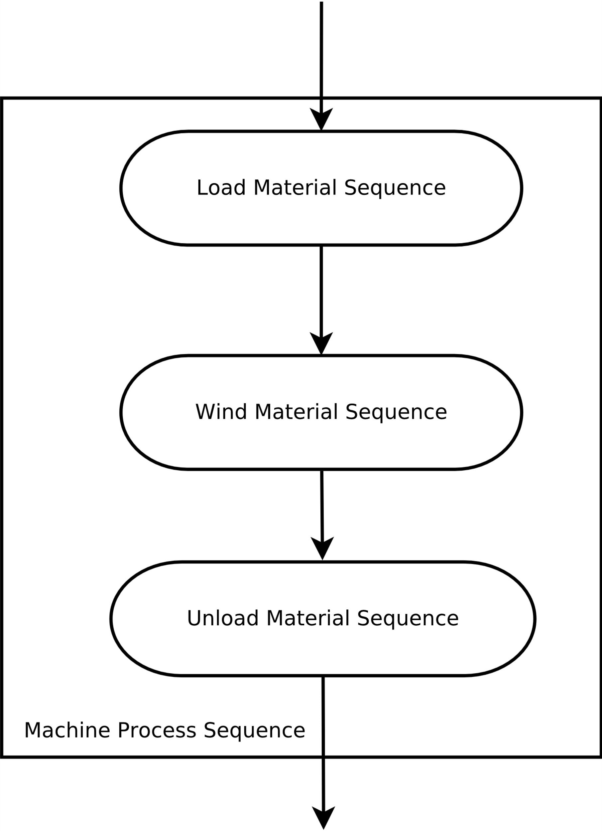
PLC Programming
Machine Process
  Used flowchart to define the process and module so that a team of programmer can work on the same project at same time.
  Define the overall process Ex. (Battery Winder)
    Load Material Sequence
    Wind Material Sequence
    Unload Material Sequence
  Further brake down the process
    Load Material Sequence
      Stage

Slide 6
PLC Programming
Counter Process
  Used to process to all the counter info that has been incremented in the last machine cycle
  Determine whether to stop or display a message.

Slide 7
PLC Programming
Machine Process
  Further brake down the process (Ex Load Material Sequence)
    Stage

Slide 8
PLC Programming
Stop Cycle Process

