Slide 1
PLC Programming
Paradigm
State Machine
Problems with large programs and the solution

Slide 2
PLC Programming -- Structure Programming
Key Concepts
  Modularization
  Use of Subroutines and Functions
    Top-Down Design
    Block Structures
    Single Entry and Exit Points
  Control Structures
  Data Structuring
  Comments and Documentation
  Consistent Naming Conventions

Slide 3
PLC Programming -- Structure Programming
Benefits
  Readability
  Maintainability
  Reusability
  Reliability
  Testability

Slide 4
PLC Programming
Solving the problem with writing big programs
  Use programming paradigm
    Structured programming is a programming paradigm aimed at improving the clarity, quality, and development time of a computer program by making extensive use of the structured control flow constructs of selection (if/then/else) and repetition (while and for), block structures, and subroutines in contrast to using simple tests and jumps such as the go to statement, which can lead to “spaghetti code” that is potentially difficult to follow and maintain.
      https://press.rebus.community/programmingfundamentals/chapter/structured-programming/
  Develop a framework
    Descries a set of solutions and processes to aid in the development of software
    Benefits
      Saves time
      Ensure best practices are followed

Slide 5
PLC Programming
Control Structures
  The mechanisms that allow us to control the flow of execution are called .
    Sequence
      Do one instruction then the next and the next.
      Just do them in a given sequence or in the order listed
    Selection
      Choose between two or more flows.
    Iteration, Repetition or Looping
      Allows code to be executed several times until some condition has been met
https://press.rebus.community/programmingfundamentals/chapter/structured-programming/

Slide 6
PLC Programming
Defining a Control Structure
  That can run a sequence in a controlled fashion
    Numerically Sequenced
      To easily follow the path of execution
  Can be skipped to improve cycle time
    Use jump and label in a limit fashion
    Stage and End Stage command
    Controlled by an enable flag (bit)
  Enter or start the Control Structure
    Start process flag
  Exit or stop the Control Structure
    Stop process flag
    Stop and cleans up the Control Structure process

Slide 7
PLC Programming
Each PLC provides a different way of accessing bits
So it up to the individual programmer to develop the control structure to meet the hardware constraints.
The following slide will show 3 different implementation used in various PLC

Slide 8
PLC Programming
Defining a Control Structure for Omron CX-Programmer

Slide 9
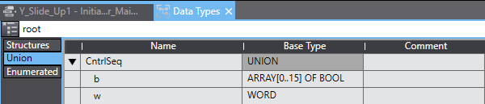
PLC Programming
Defining a Control Structure for Omron SYSMAC
In the SYSMAC environment
  The use of Union was the best way I found to access the BITS in a WORD
  Since a Union is a set of variables with same offset therefore occupies the same memory space.
  Hence, b is array of 16 Boolean that can directly access the bits in the WORD.

Slide 10
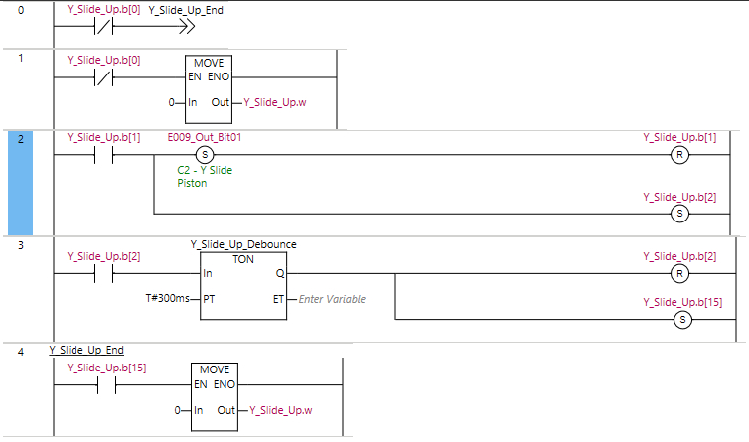
PLC Programming
Defining a Control Structure for Omron SYSMAC
In the SYSMAC environment
  This the basic control structure that was developed.
  Y_Slide_Up variable is defined by Union definition in the previous screen call CntrlSeq
  Bit 0 is the enabling bit
  If the Bit 0 is off, jump statement is enable and takes the execution of PLC code to the end of the control structure
  Bit 1 is the Starting bit
  Y_Slide_Up.b(1) rung sets an output variable “E009_Out_Bit01” then proceed to reset the current rung Y_Slide_Up.b(1) then set the next rung Y_Slide_Up.b(2) .
  Y_Slide_Up.b(2) Rung enables a Timer On function block defined by time variable T#300ms.

Slide 11
PLC Programming
Defining a Control Structure for Omron SYSMAC
    bit
In the SYSMAC environment
  Y_Slide_Up.b(2) Rung enables a Timer On function block defined by time variable T#300ms.
  Once the timer complete Y_Slide_Up.b(2) is reset and Y_Slide_Up.b(15) is set.
  Y_Slide_Up.b(15) is the stop flag which activate the MOVE function that copy 0 to WORD portion that resets all of the bit in the CntrlSeq variable.

Slide 12
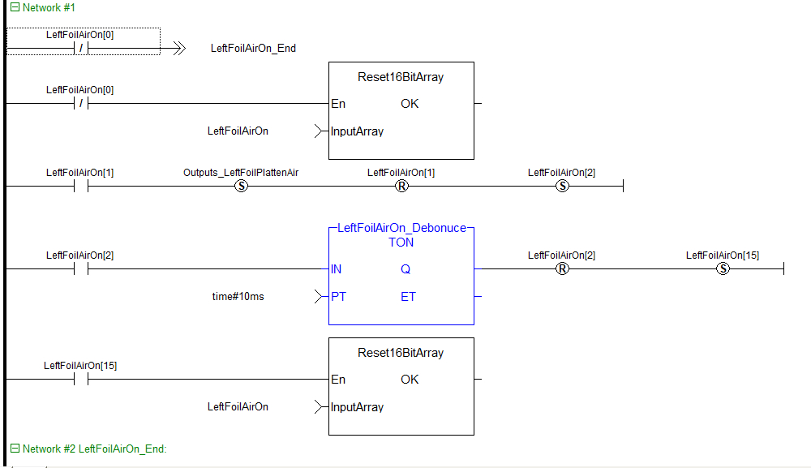
PLC Programming
Defining a Control Structure for Kollmorgen Automation Suite
LeftFoilOn[x] is an array of 16 bool
LeftFoilOn[0] is the Enabling bit
If LeftFoilOn[0] is Off the
  -->> LeftFoilAitOn_End is the Jump Statement that bypasses this Network of code.
  On Network #2: LeftFoilAirOn_End is the label that the Jump statement refers to.
The Reset16BitArray function block is used to reset the individual bits in the array
LeftFoilOn[1] is the starting bit for the block of code
LeftFoilOn[1] rung sets an output variable “Outputs_LeftFoilPlattenAir” then proceed to reset the current rung LeftFoilOn[1] then set the next rung LeftFoilOn[2].

Slide 13
PLC Programming
Defining a Control Structure for Kollmorgen Automation Suite : Continued
LeftFoilAirOn[2] Rung enables a Timer On function block defined by literal time variable time#10ms.
After 10ms the LeftFoilAirOn[2] rung is Reset and the Last Bit in the array is set to finish the block.
LeftFoilAirOn[15] activates the Reset16BitArray function block which reset the array of bits in the LeftFoilAirOn array thereby turning off the block of code.
This block code represents the basic building block of ladder logic that will be used to write your programs.

Slide 14
PLC Programming
Defining a Control Structure for Kollmorgen Automation Suite : Continued
LeftFoilAirOn[2] Rung enables a Timer On function block defined by literal time variable time#10ms.
After 10ms the LeftFoilAirOn[2] rung is Reset and the Last Bit in the array is set to finish the block.
LeftFoilAirOn[15] activates the Reset16BitArray function block which reset the array of bits in the LeftFoilAirOn array thereby turning off the block of code.
This block code represents the basic building block of ladder logic that will be used to write your programs.

